Slide 1
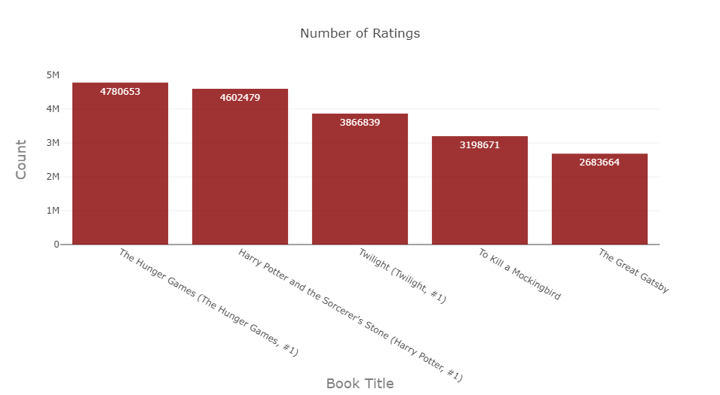
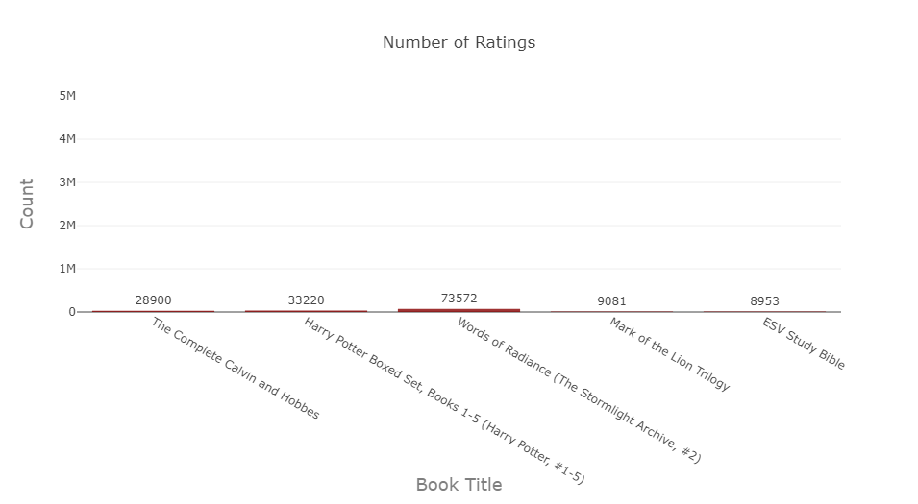
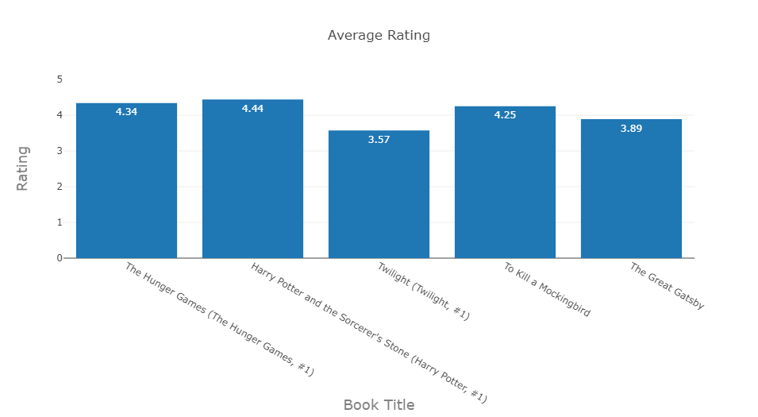
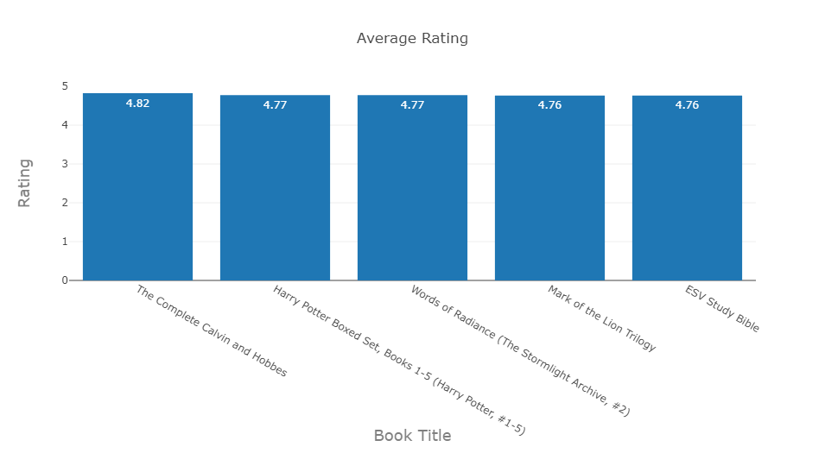
Top 5 Books by Number of Ratings
Top 5 Books by Average Rating
Do the books with the most number of ratings also have the highest average ratings?
Notes:
Do the books with the most number of ratings also have the highest average ratings?

Slide 2
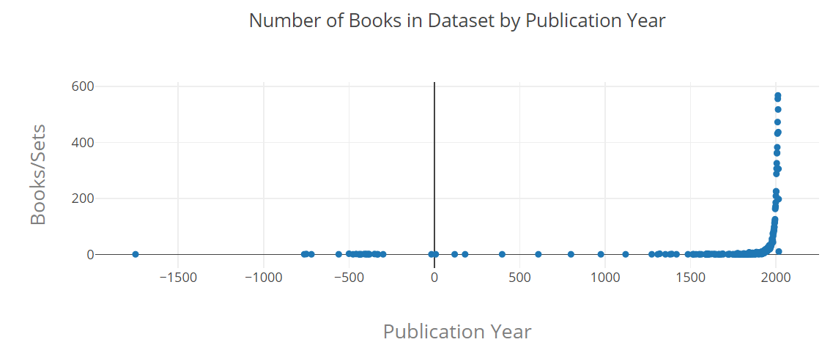
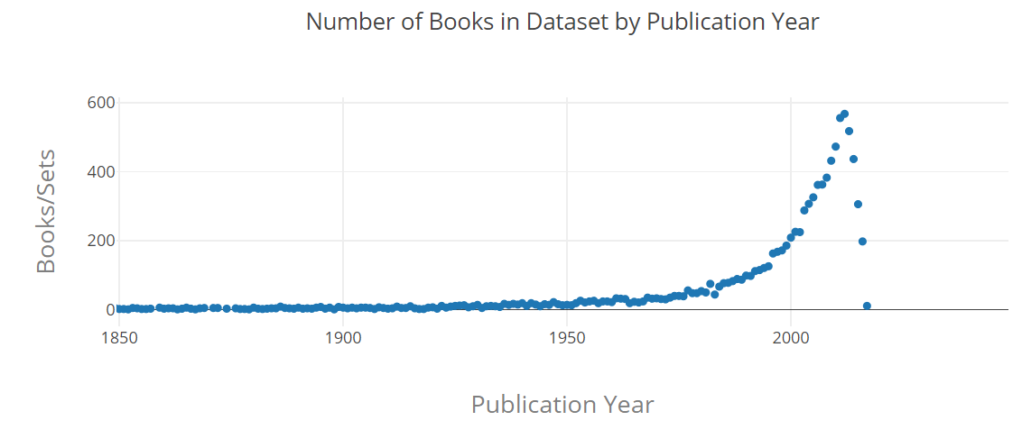
Are books that are more recently published
more popular? (The dataset Includes 10,000
of the most popular books on
Goodreads.com)
As the publication year increases,
so does the number of books found
in this dataset. We should keep in mind that the number of books published per year is increasing as well.

Slide 3
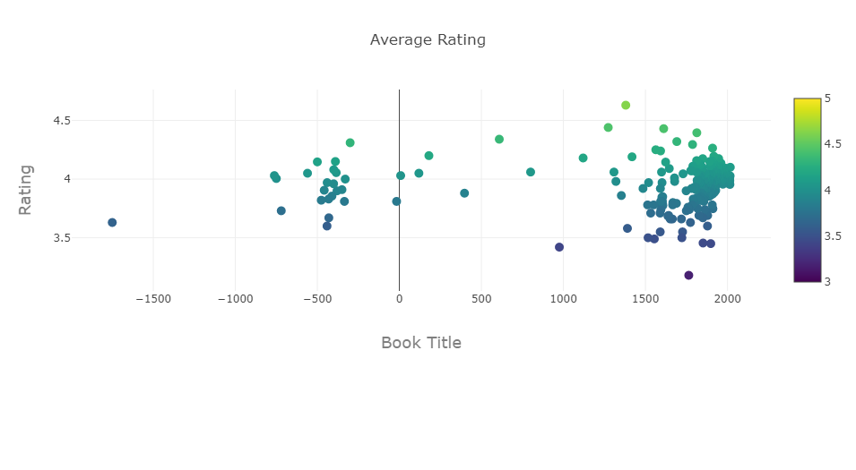
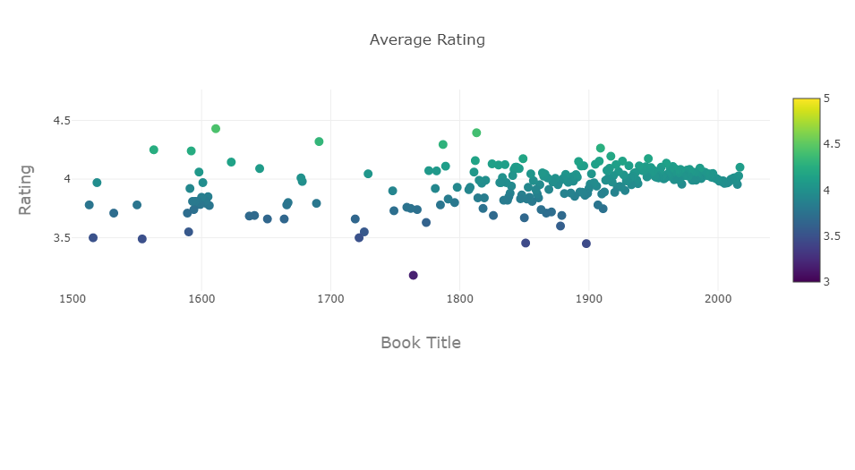
\
Does the average rating of books change
with the publication year?
It is definitely not constant throughout the years.
However, the average rating seems to be getting
more stable

